Slide 1
Lustre* Filesystem
Doug Oucharek
Intel® High Performance Data Division
* Some names and brands may be claimed as the property of others.

Slide 2
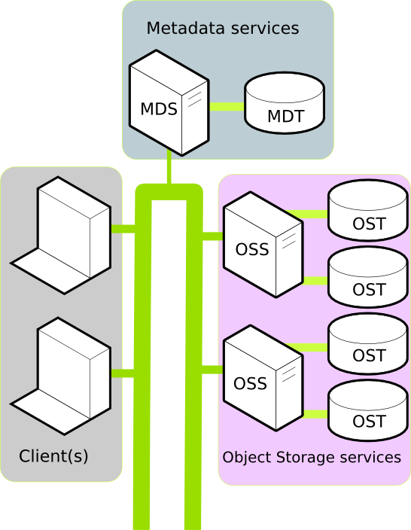
Lustre and LNet

Slide 3
LNet and OFED

Slide 4
Example: Sending File Data

Slide 5
Health Network: Now and Future
Today: Peer to Peer pings (O(n))
Future: Gossip Protocol
Fault tolerant O(log n) global state distribution latency

Slide 6
What LNet Needs Going Forward
Reliable Datagram
  No order preservation required
  Small max size (e.g. 1k)
  Receivers are guaranteed eager
  Senders will adhere to injections limits
  Network only drops datagrams on transmission failure (dead peer, broken link), not on congestion
RMA
  PUT & GET
  Passive side buffers guaranteed pre-registered (network may discard if no match)
  1k <= size <= sensible max (e.g. 1MB)
High Priority Messages for Health Network
  Vastly reduced injection rate
  These messages come before anything else in all devices (i.e. switches)

Slide 7
Thank You

