Slide 1
Use case of RDMA in Symantec storage software stack
Om Prakash Agarwal
Symantec

Slide 2
Agenda
About Symantec Storage Software Stack
Need for the faster interconnects
Write operation without and with RDMA
Implementation details: Write operation with RDMA
Perf comparison (without and with RDMA)

Slide 3
About Symantec Storage Software Stack
User
Applications
Applications
CVM/CFS
CVM/CFS
Kernel
LLT
LLT
HBA
NIC
NIC
HBA
Hardware
Shared storage

Slide 4
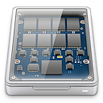
Need for the faster interconnects
User
Applications
Applications
CVM/CFS
CVM/CFS
Kernel
LLT
LLT
NIC
NIC
Hardware
Local storage
Local storage
Shared Nothing Architecture

Slide 5
Write operation without and with RDMA
CVM/CFS
CVM/CFS
Buffer
Bufptr
Kernel
LLT
LLT
Bufptr
Buffer
RNIC
RDMA over InfiniBand or Ethernet
RNIC
Hardware
NIC
NIC

Slide 6
Write operation with RDMA
sender
receiver
Message
4k
4k
8k
1k
1k
Message
4k
4k
4k
4k
2k
CVM/CFS
Buffer advertisement:
Allocate buffers and send
Meta data to sender node.
TX map
Destination buffer info
TX map
Destination buffer info
TX map
Destination buffer info
TX map
Destination buffer info
RX map
Actual allocation
RX map
Actual allocation
RX map
Actual Allocation
RX map
Actual Allocation
4k
4k
4k
4k
4k
4k
4k
4k
4k
4k
4k
4k
4k
4k
4k
4k
4k
4k
4k
4k
4k
4k
4k
4k
LLT
4k
4k
4k
4k
4k
4k
4k
4k
4k
4k
4k
4k
4k
4k
4k
4k
4k
4k
4k
4k
4k
4k

Slide 7
Perf comparison (without and with RDMA)
Throughput
Latency
Setup configuration
Two node Linux (RHEL6.3) cluster
ConnectX3 VPI NIC card from Mellanox
IB -56 Gbps
RoCE-40 Gbps
Eth-40 Gbps
3.3GHz Processor

Slide 8
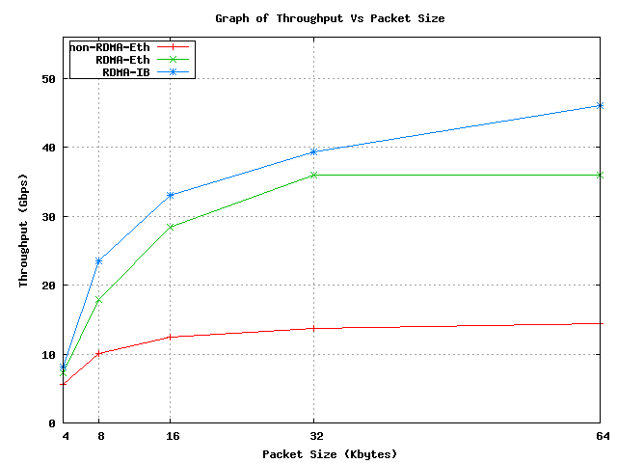
LLT perf comparison : Throughput
Higher is better
193%
125%

Slide 9
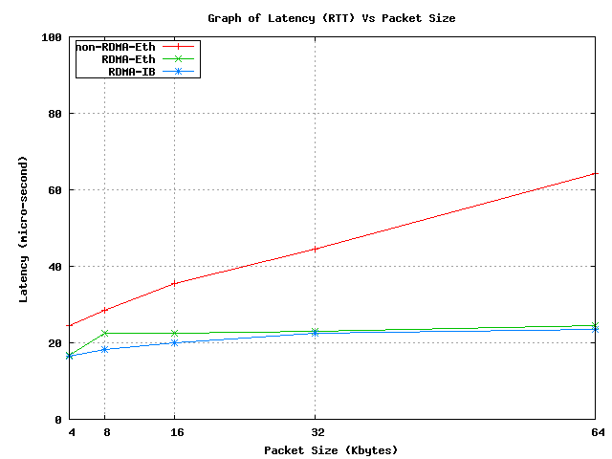
LLT perf comparison : Latency
62%
Lower is better

Slide 10
Thank You

