Slide 1
Current Status of OFED in SUSE Linux Enterprise Server
John Jolly
Senior Software Engineer
SUSE

Slide 2

Agenda
About SUSE
About SUSE Linux Enterprise Server
OFED Integration into SLES
Future Direction of OFED in SLES
2

Slide 3





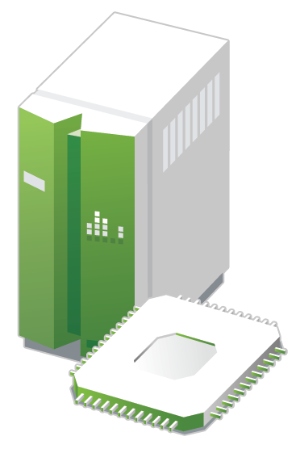

SUSE and the Attachmate Group
SUSE, headquartered in Nürnberg / Germany,
is an independently operating business unit of
The Attachmate Group, Inc.
The Attachmate Group is a privately held
1 billion+ $ revenue software company
with four brands:
Cloud Infrastructure
Enterprise Computing
Integrated Systems

Slide 4








SUSE® Linux Enterprise
How We Build It
Online
Repository
Source Package Image
OBS
OBS user submits source
to OBS and gets a product

Slide 5
SUSE® Linux Enterprise Server 12
Lifecyle Model
13-year lifecycle (10 years general support, 3 years extended support)
5-year lifecycle per Service Pack (2 years general + 3 years extended support)
Long Term Service Pack Support (LTSS) available for all versions, including GA

Slide 6
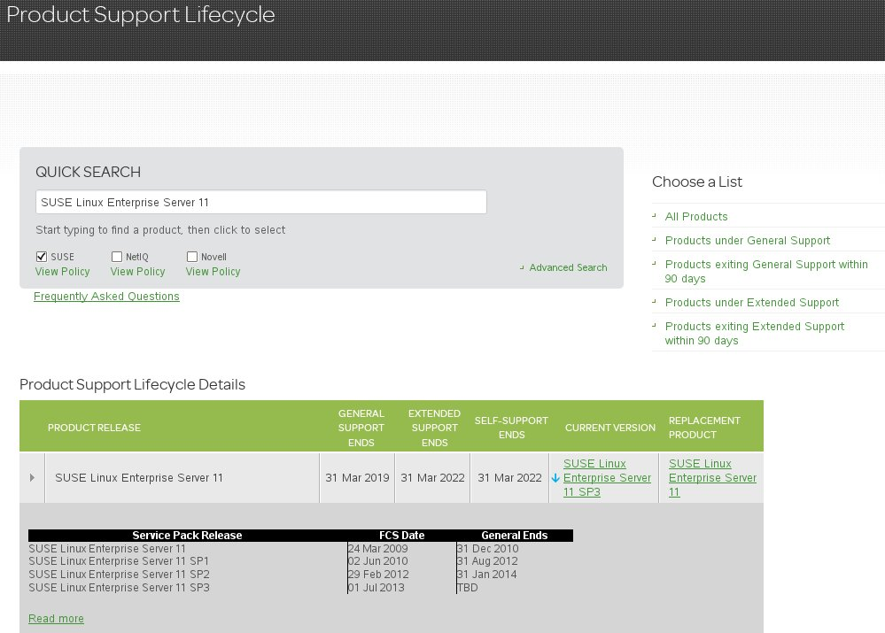
http://www.suse.com/lifecycle/

Slide 7
Unique Tools Included
AppArmor Security Framework
  Application confinement
Free High Availability Extension
  Cluster Framework, Cluster FS, DRBD, GEO-cluster*
YaST2 systems management
  Install, deploy, and configure every aspect of the server
Subscription Management Tool
  Subscription and patch management, proxy/mirroring/staging
Starter System for System z
  A pre-built installation server, deployable with z/VM tools

Slide 8
Features of SLES 12
Linux Kernel 3.12
Only 64-bit kernel
  Support of 32-bit application through execution environment
YaST modules written in Ruby
OFED 3.12
  Significant backport assistance from HCA vendors (Intel, Mellanox, etc.)
Installation default to btrfs
  Provides snapshots, copy-on-write, subvolumes, scalable to 16EiB

Slide 9
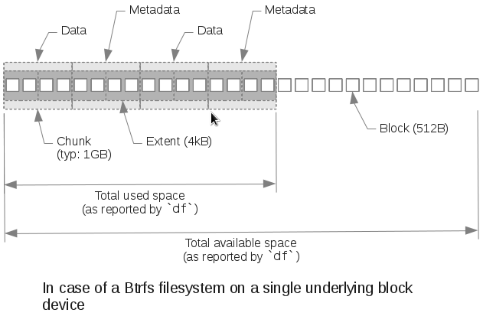
Btrfs Disk Space And Extents
# btrfs filesystem df /
Data: total=14.50GB, used=12.20GB
System, DUP: total=8.00MB, used=12.00KB
System: total=4.00MB, used=0.00
Metadata, DUP: total=1.75GB, used=904.11MB
# df -h /
Filesystem Size Used Avail Use% Mounted on
/dev/sda7 20G 14G 4.3G 77% /
#
Disk utilization
12,2GB + 2x 0,9GB + = 14 GB

Slide 10
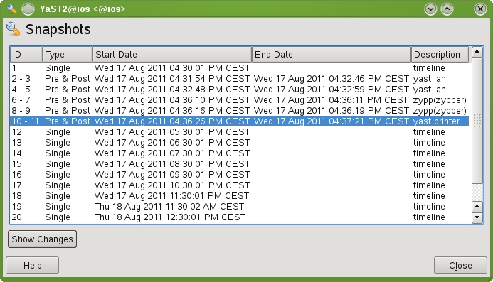
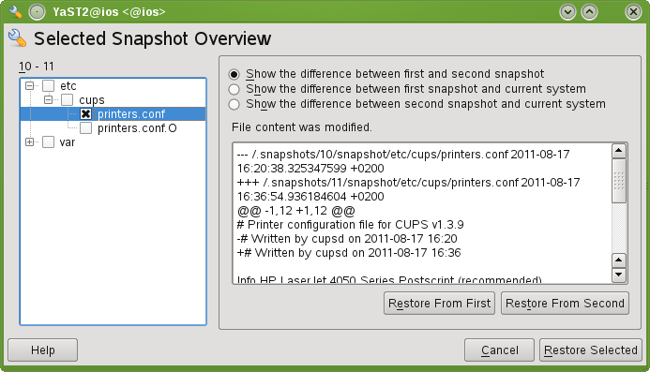
Snapshots in SUSE® Linux Enterprise 11 SP3
YaST2 Management

Slide 11
OFED 3.12
Official Open-Source Distribution from The Openfabrics Alliance
Up-to-date as of OFED 3.12-rc1
  Initialization scripts package renamed to rdma
  Library packages postfixed with -rdmav2
  infinipath-psm v3.2
  opensm v3.3.17

Slide 12
How you can help
Report bugs
  http://bugzilla.novell.com
Participate in feature submission
  http://fate.suse.com
Use the Open Build Service
  https://build.opensuse.org
  SLES 10 and 11, openSUSE, Fedora, RHEL, Debian, Ubuntu
  x86 and x86_64, powerpc, ppc64, armv5el, armv7l, armv7hl
  Install and manage your own build service

Slide 13
Thank you!
13

