Slide 1
NVM Programming Model

Slide 2
Emerging Persistent Memory Technologies
Phase change memory
Heat changes memory cells between crystalline and amorphous states
Spin torque memory/MRAM
Magnetic layers within memory cells are aligned or juxtaposed
Resistive RAM
Ion concentrations are migrated within memory cells to change resistance
All of these can have latencies close enough to DRAM
to allow them to be accessed like DRAM.

Slide 3
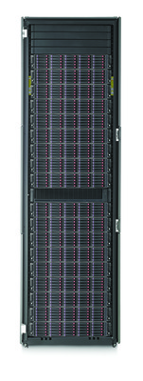
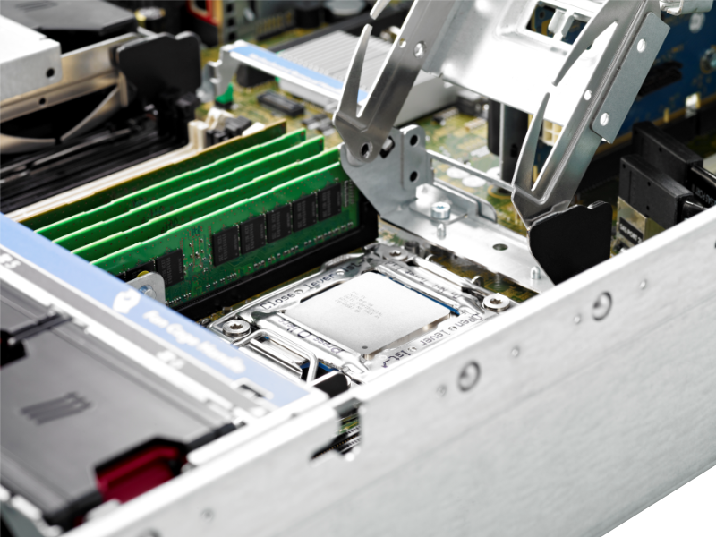
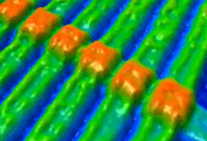
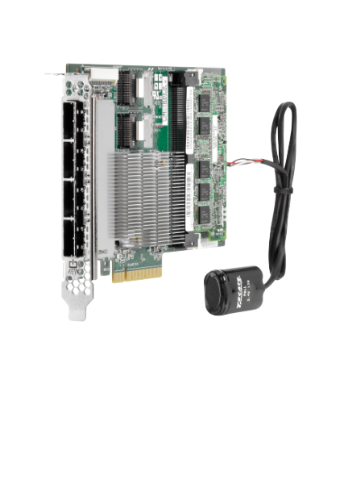
Persistent Memory Vision
PM Brings Storage
Fast Like Memory
PM
Durable
Like Storage
To Memory Slots
Make Data Durable Without Doing IO!

Slide 4
Application View of IO Elimination
Non-Blocking
NUMA
Software overheads are being driven to keep pace with devices
NUMA latencies up to 200 nS have historically been tolerated
Anything above 2-3 uS will probably need to context switch
Latencies below these thresholds cause disruption

Slide 5
SNIA NVM Programming Model Version 1
Approved by SNIA in December
Downloadable by anyone
Expose new features of block and file to applications
Atomicity capability and granularity
Thin provisioning management
Use of memory mapped files for persistent memory
Existing abstraction that can act as a bridge to higher value from persistent memory
Limits the scope of re-invention from an application point of view
Open source implementations already available for incremental innovation (e.g. PMFS)
Programming Model, not API
Describes behaviors in terms of actions
Facilitates discovery of capabilities using attributes
Usage illustrated as Use Cases
Implementations map actions and attributes to API elements

Slide 6
Conventional Block and File Modes
BLOCK mode describes extensions:
Atomic write features
Granularities (length, alignment)
Thin Provisioning Management
FILE mode describes extensions:
Discovery and use of atomic write features
The discovery of granularities (length, alignment characteristics)
Memory Mapping in NVM.FILE mode uses volatile pages and writes them to disk or SSD
Notes:
Note the statement at the bottom about memory mapping in NVM.FILE; next slide mentions the difference with PM

Slide 7
Persistent Memory Modes
NVM.PM.VOLUME mode provides a software abstraction to OS components for Persistent Memory (PM) hardware:
list of physical address ranges for each PM volume
Thin provisioning management
NVM.PM.FILE mode describes the behavior for applications accessing persistent memory including:
mapping PM files (or subsets of files) to virtual memory addresses
syncing portions of PM files to the persistence domain
Memory Mapping in NVM.PM.FILE mode enables direct access to persistent memory using CPU instructions

Slide 8
What's next for NVM programming?
Beyond version 1, three work items are under investigation
Software hints
Application usage , access patterns
Optimization based on discovered device attributes
Present hints emerging in standards (SCSI, NVMe) to applications
Atomic transactional behavior
Add atomicity and recovery to programming model
Not addressed by current sync semantics
Remote access
Disaggregated memory
RDMA direct to NVM
High availability, clustering, capacity expansion use cases

Slide 9
RDMA Challenge
Use case:
RDMA writing to persistent memory
within a memory mapped file
built on NVM.PM.FILE from version 1 programming model
How can the initiator of the RDMA efficiently learn when data is persistent at the remote side?
Sync semantics for remote access
Flushing processor queues on the remote end

Slide 10
Discussion

